Slide 1
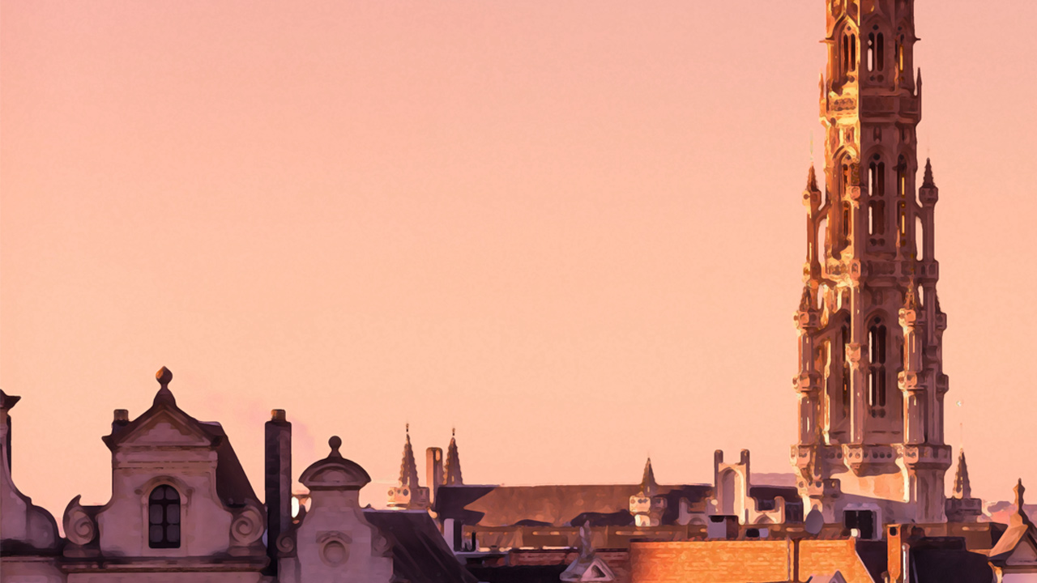
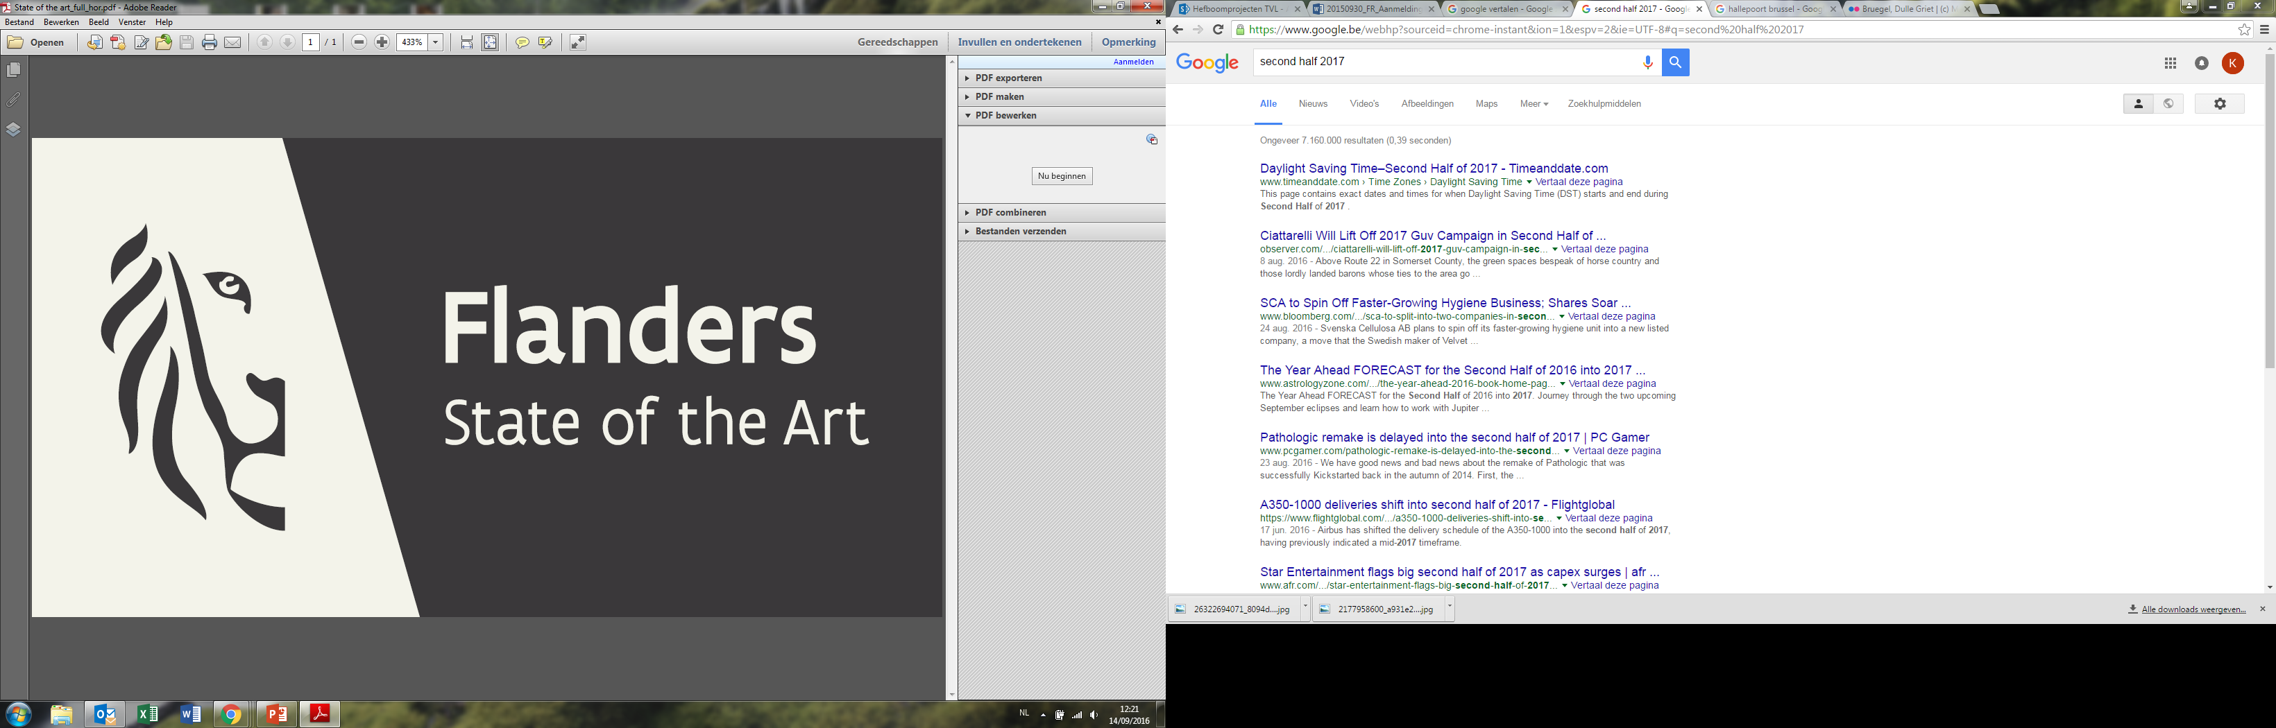




Reputation Study
Flanders 2017
Mature Markets
Europe + US & Japan
VISITFLANDERS

Slide 2
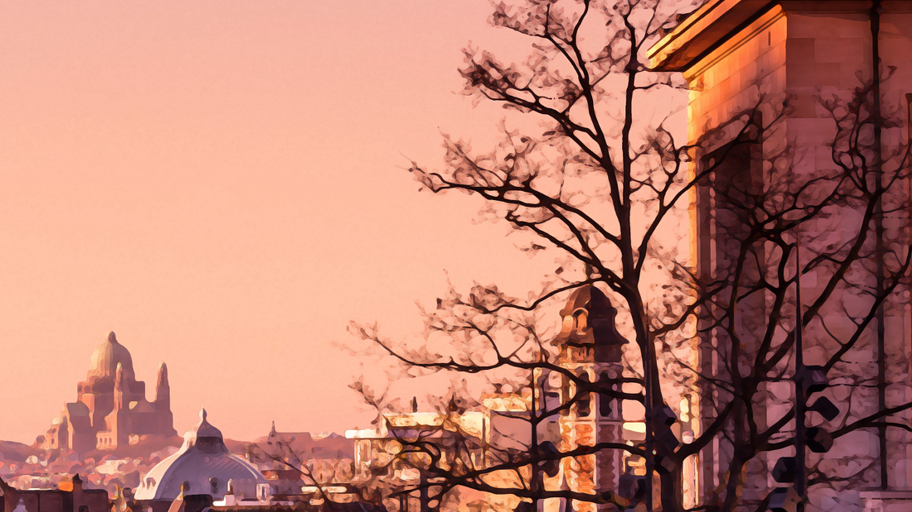


THE STORY LINE
What do travellers KNOW & how do they EXPERIENCE Flanders?
How is Flanders CONNECTED to travellers?
VISITFLANDERS

Slide 3



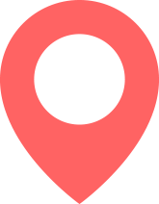
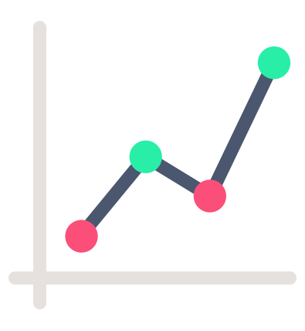
METHODOLOGY
Results are
representatively weighted
(socio demographics
+ by market)
1,000 completes per country
Online research in 13 mature markets
People who have travelled abroad in the past 3 years
Totals are made for the
sum of the European markets, comparison can be made per market and with US and Japan
VISITFLANDERS

Slide 4
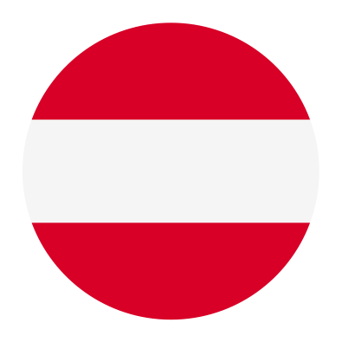
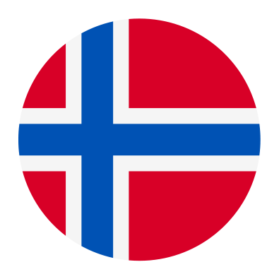

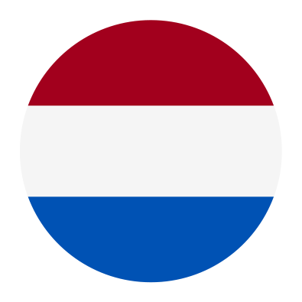
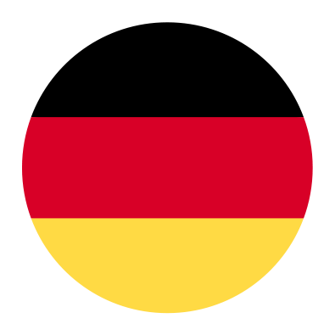
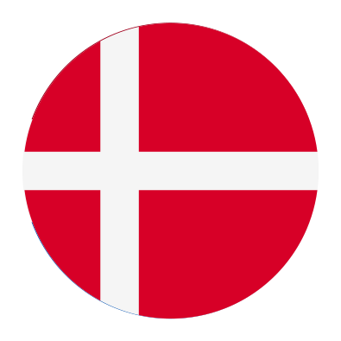
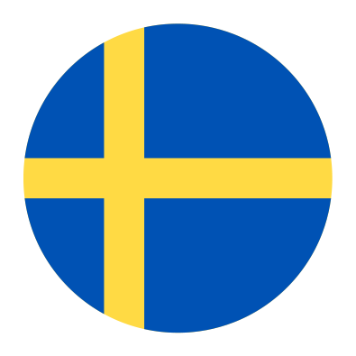
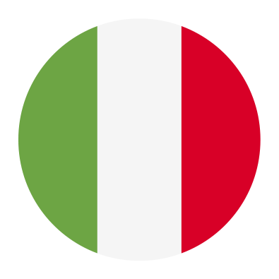
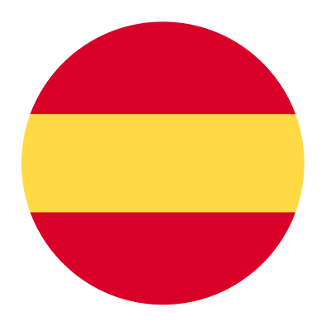

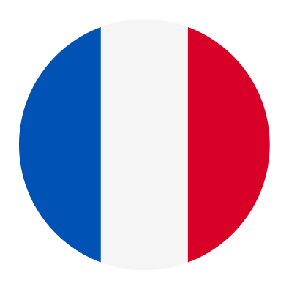

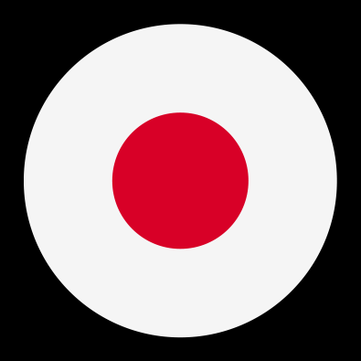
Proportion of population that travelled abroad in the past 3 years differs greatly per country.
If totals are shown, they are for this group of European countries
Non European residents travel less abroad.
VISITFLANDERS
Base: Mature market – all travellers
S1. In the past 3 years, did you travel abroad (staying at least one night) for a short break/holiday or business trip?

Slide 5
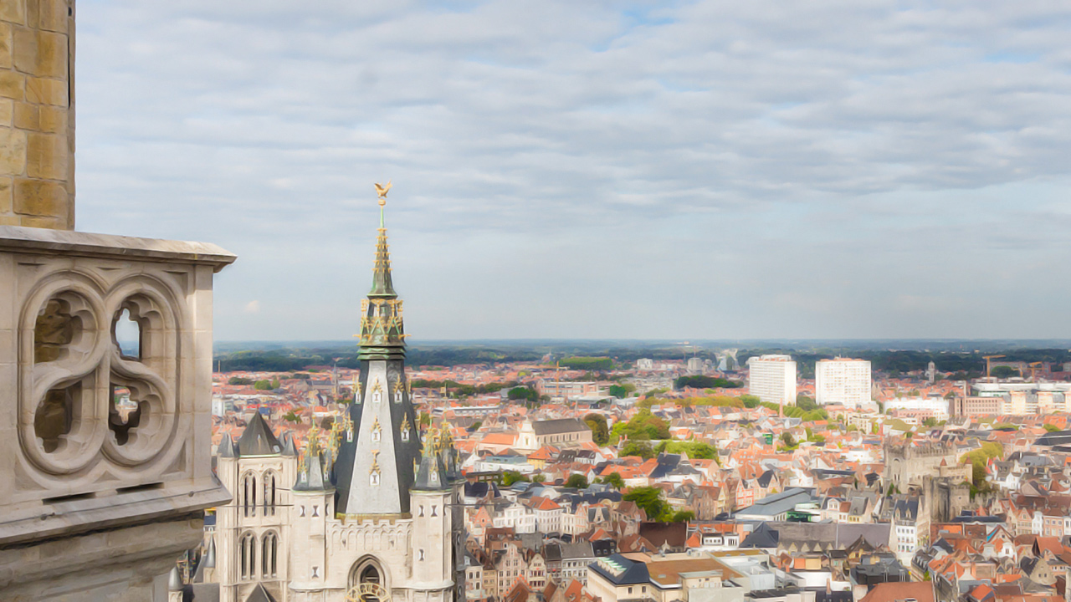
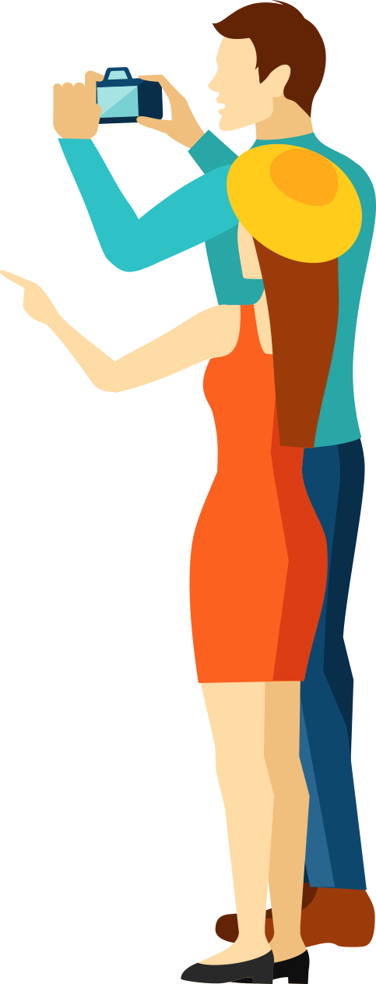
In Depth
Results
VISITFLANDERS

Slide 6
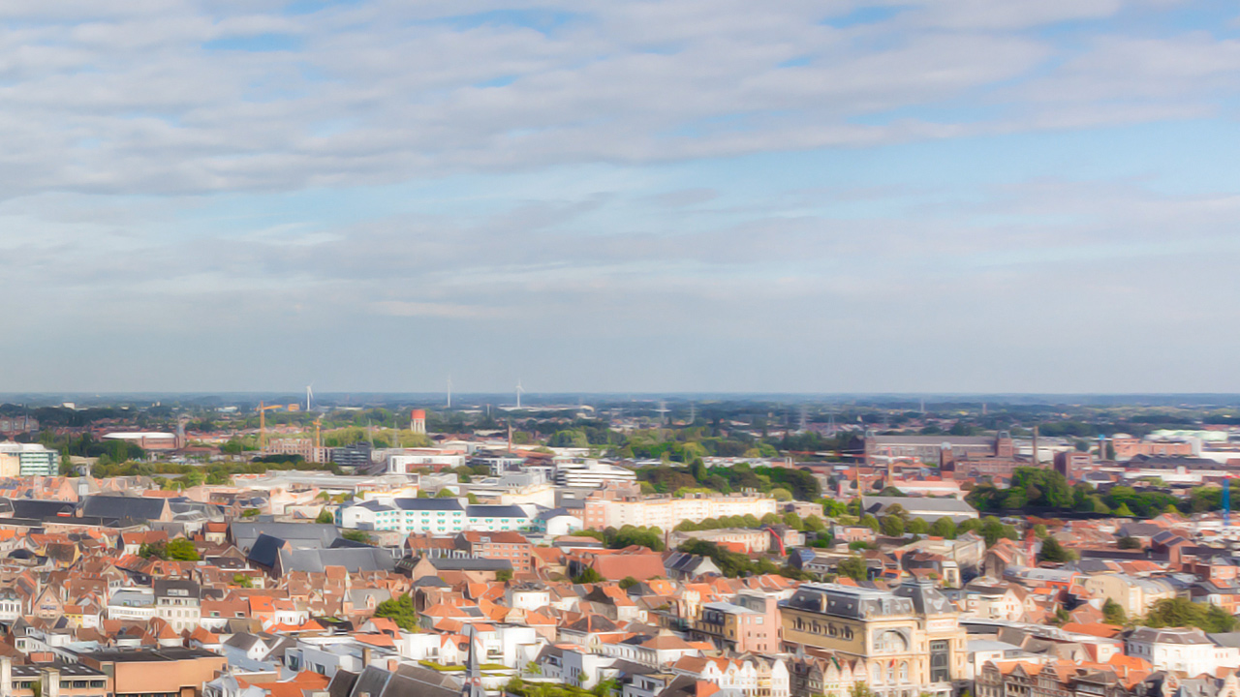
THE STORY LINE
What do travellers KNOW & how do they EXPERIENCE Flanders?
How is Flanders CONNECTED to travellers?
How well do travellers know the region(s), the cities, the country?
Do they know the USP ‘s of Flanders?
How do travellers perceive Flanders? (Associations with Flanders)
How was their journey experience?
What is the visit intention? For what type of journey?
How well are travellers connected to Flanders? Which relationship do they have with Flanders?
VISITFLANDERS

Slide 7
Knowledge and Experience of Flanders
Knowledge of:
Associations with Flanders
The journey experience
the region(s), the cities,
the country and the USP‘s
VISITFLANDERS

Slide 8


About 5 out of 10 European travellers have visited Flanders/Brussels or a city within Flanders. More than 9 out of 10 are (quite) familiar with Flanders.
Familiar*
Visited
% that visited or are very familiar with
% that visited.
VISITFLANDERS
*Familiar = visited or heard/read about it AND can picture it
Base: European market – all travellers
Q1. Are you familiar with one of the following regions/cities?

Slide 9
People from the neighbouring countries have visited Flanders (or a city within Flanders) the most AND are quite familiar with Flanders.
TOTAL
Europe
FAMILIAR
NL | FR | DE | UK | ES | IT | NO | DK | SE | CH | AT | US | JP
98% | 94% | 95% | 88% | 94% | 96% | 88% | 83% | 86% | 93% | 98% | 78% | 61%
Flanders, or Brussels or one of the other cities
TOTAL
Europe
VISITED
NL | FR | DE | UK | ES | IT | NO | DK | SE | CH | AT | US | JP
92% | 61% | 47% | 51% | 45% | 43% | 38% | 35% | 36% | 42% | 37% | 34% | 17%
Flanders, or Brussels or one of the other cities
VISITFLANDERS
Base: European market – all travellers
Q1. Are you familiar with one of the following regions/cities? % that visited.

Slide 10
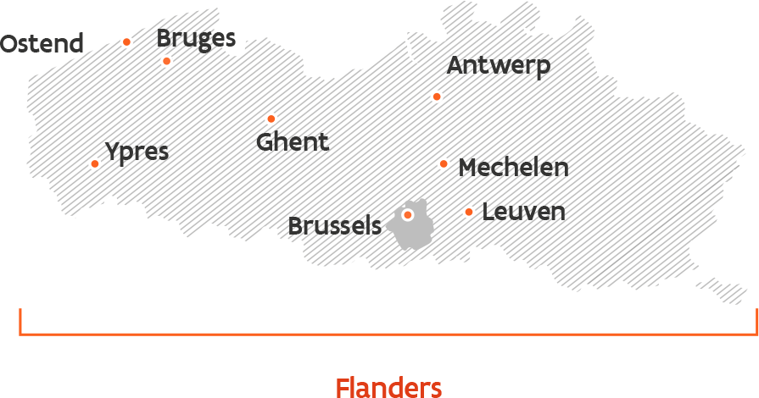
Familiarity with Belgium, Brussels, Flanders and the most important cities (EUROPEAN MARKETS)
48%
93%
74%
61%
30%
76%
34%
Belgium
90%
40%
72%
VISITFLANDERS
Base: European market – all travellers
Q1. Are you familiar with one of the following regions/cities?

Slide 11
Familiarity is highest with Belgium, Brussels and Flanders.
Mechelen and Ypres are the least known.
(results for European markets)
3,0
2,9
2,9
3,3
2,6
2,1
1,9
1,9
2,3
3,4
knowledge
score (max=4)
The knowledge score is an average calculated from the answer scale (used scores mentioned next to the legend points)
VISITFLANDERS
Base: European market – all travellers
Q1. Are you familiar with one of the following regions/cities?

Slide 12
% that KNOWS (is familiar with) Flanders, Brussels or one of the (art) cities
(heard/read about it, or visited)
separate scores/city or region:
 | TOTAL EUROPE | NL | FR | DE | UK | ES | IT | NO | DK | SE | CH | AT | US | JP
Flanders | 72% | 97% | 76% | 72% | 57% | 76% | 79% | 51% | 46% | 49% | 69% | 79% | 40% | 33%
Antwerp | 74% | 97% | 70% | 83% | 57% | 73% | 76% | 62% | 52% | 60% | 75% | 90% | 41% | 36%
Bruges | 76% | 95% | 81% | 79% | 67% | 87% | 71% | 54% | 46% | 51% | 67% | 82% | 36% | 25%
Brussels | 90% | 97% | 90% | 93% | 81% | 91% | 93% | 83% | 78% | 84% | 91% | 97% | 71% | 56%
Ghent | 61% | 94% | 55% | 71% | 50% | 69% | 47% | 51% | 38% | 56% | 61% | 74% | 36% | 16%
Leuven | 40% | 85% | 46% | 44% | 28% | 43% | 28% | 32% | 23% | 32% | 40% | 45% | 27% | 15%
Mechelen | 34% | 83% | 35% | 40% | 20% | 31% | 25% | 28% | 20% | 30% | 35% | 41% | 26% | 9%
Ypres | 30% | 65% | 34% | 30% | 41% | 23% | 20% | 20% | 14% | 18% | 23% | 25% | 26% | 7%
Ostend | 48% | 81% | 50% | 60% | 49% | 31% | 32% | 31% | 25% | 33% | 46% | 61% | 26% | 9%
Belgium | 93% | 99% | 95% | 97% | 85% | 95% | 93% | 91% | 84% | 88% | 93% | 99% | 76% | 83%
VISITFLANDERS
Base: Mature market – all travellers
Q1. Are you familiar with one of the following regions/cities?

Slide 13
% that VISITED Flanders, Brussels or one of the (art) cities
(heard/read about it, or visited)
separate scores/city or region:
 | TOTAL EUROPE | NL | FR | DE | UK | ES | IT | NO | DK | SE | CH | AT | US | JP
Flanders | 40% | 91% | 48% | 38% | 45% | 38% | 28% | 30% | 21% | 25% | 30% | 27% | 28% | 12%
Antwerp | 20% | 80% | 21% | 19% | 14% | 18% | 14% | 16% | 11% | 15% | 15% | 14% | 10% | 7%
Bruges | 26% | 59% | 37% | 21% | 30% | 31% | 17% | 12% | 11% | 13% | 16% | 16% | 12% | 8%
Brussels | 38% | 67% | 51% | 32% | 33% | 38% | 34% | 26% | 28% | 31% | 34% | 30% | 22% | 15%
Ghent | 15% | 52% | 18% | 11% | 13% | 17% | 8% | 10% | 5% | 10% | 10% | 12% | 11% | 4%
Leuven | 7% | 26% | 9% | 5% | 6% | 5% | 4% | 6% | 3% | 4% | 5% | 4% | 10% | 2%
Mechelen | 5% | 21% | 5% | 4% | 5% | 3% | 3% | 4% | 2% | 3% | 3% | 2% | 11% | 1%
Ypres | 5% | 13% | 9% | 2% | 12% | 2% | 3% | 4% | 2% | 2% | 2% | 1% | 7% | 1%
Ostend | 15% | 36% | 18% | 19% | 19% | 5% | 5% | 8% | 6% | 8% | 10% | 14% | 10% | 2%
Belgium | 50% | 97% | 64% | 52% | 46% | 41% | 37% | 33% | 38% | 39% | 42% | 36% | 24% | 16%
VISITFLANDERS
Base: Mature market – all travellers
Q1. Did you visit one of the following regions/cities?

Slide 14

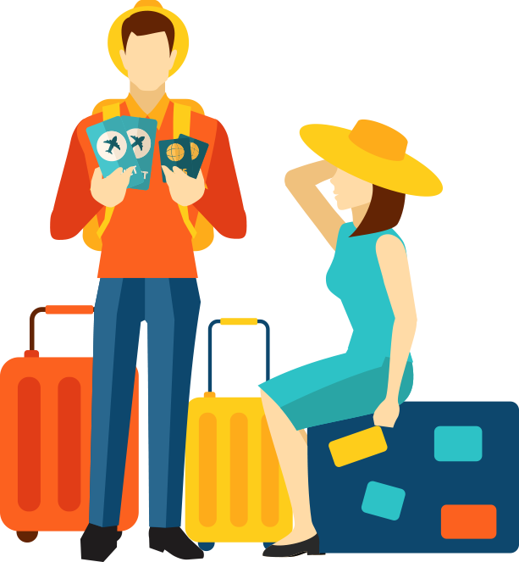
Important remark
Following results are based on people who are familiar with Flanders or a city in Flanders.
VISITFLANDERS

Slide 15
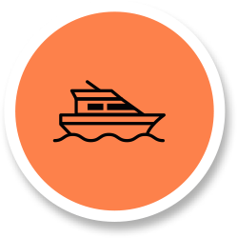
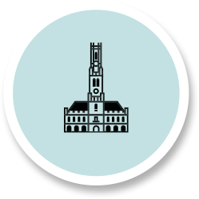
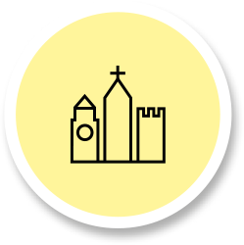
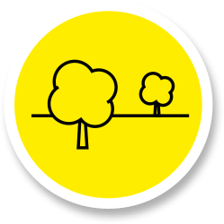
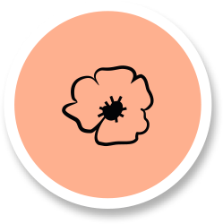
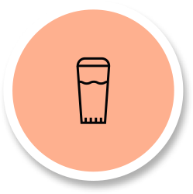


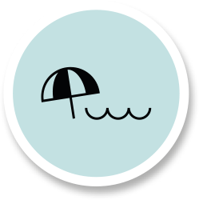



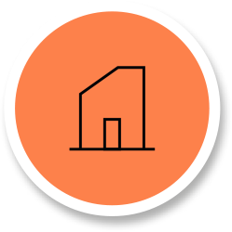
Spontaneous associations with “Flanders”
(total Europe)
18%
17%
17%
15%
14%
14%
Harbour,
ship
Heritage
(historic buildings)
City (general),
old cities
Nature &
beautiful landscapes
(First and second)
world war
Beer
13%
13%
13%
11%
11%
9%
7%
Art and
artists, museum
History/
culture
Beach/
coast
Language/
accent (Dutch)
Tasty food
& drinks
Chocolate
& pralines
Architecture
VISITFLANDERS

Slide 16
Spontaneous associations with “Flanders”
differ greatly from country to country (open-ended question)
 | TOTAL EUROPE | NL | FR | DE | UK | ES | IT | NO | DK | SE | CH | AT | US | JP
Harbour, ship | 18% | 11% | 27% | 19% | 19% | 16% | 13% | 17% | 12% | 14% | 18% | 22% | 8% | 6%
Heritage (historic buildings and | 17% | 10% | 17% | 12% | 15% | 32% | 21% | 11% | 12% | 13% | 12% | 20% | 16% | 21%
City (general), old cities | 17% | 25% | 18% | 21% | 6% | 13% | 18% | 7% | 10% | 6% | 18% | 20% | 14% | 18%
Nature & beautiful landscapes | 15% | 3% | 16% | 17% | 7% | 14% | 25% | 6% | 6% | 9% | 18% | 13% | 8% | 4%
(First and second) world war | 14% | 20% | 7% | 8% | 52% | 6% | 7% | 4% | 11% | 20% | 6% | 5% | 13% | 1%
Beer | 14% | 30% | 17% | 6% | 14% | 20% | 11% | 11% | 15% | 17% | 9% | 6% | 11% | 5%
Art and artists, museum | 13% | 9% | 13% | 6% | 7% | 25% | 20% | 7% | 6% | 9% | 11% | 9% | 14% | 18%
History/culture | 13% | 8% | 10% | 13% | 8% | 22% | 16% | 8% | 4% | 5% | 9% | 12% | 19% | 5%
Beach/coast | 13% | 21% | 14% | 20% | 4% | 10% | 7% | 6% | 5% | 7% | 15% | 15% | 6% | 1%
Language/accent (Dutch) | 11% | 21% | 13% | 14% | 6% | 11% | 4% | 8% | 7% | 9% | 22% | 17% | 7% | 3%
Tasty food & drinks | 11% | 13% | 7% | 13% | 10% | 17% | 9% | 10% | 4% | 14% | 8% | 10% | 19% | 8%
Chocolate & pralines | 9% | 8% | 16% | 6% | 9% | 16% | 5% | 3% | 11% | 3% | 7% | 5% | 7% | 8%
Architecture | 7% | 3% | 8% | 3% | 6% | 21% | 6% | 4% | 2% | 1% | 5% | 5% | 6% | 5%
VISITFLANDERS
Base: Mature market – all travellers familiar with Flanders
Q5. What are the 3 most important aspects Flanders is famous for?

Slide 17
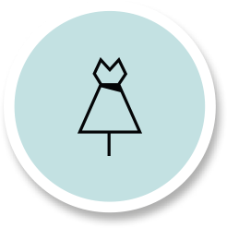
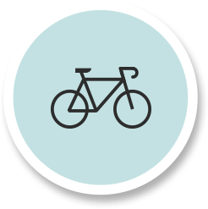

Spontaneous associations with Flanders
top 5 per market -> very different / country
Beer 30%
French Fries 28%
(old) cities 25%
University 23%
Language/accent 21%
Harbour, ship 27%
(old) Cities 18%
Heritage 17%
Beer 17%
Chocol. & pral. 16%
(old) Cities 21%
Coast 20%
Harbour, ship 19%
Nature landsc. 17%
Language/accent 14%
WWI, WW2 52%
Harbour, ship 19%
Flowers, poppies 16%
Heritage 15%
Beer 14%
Heritage 32%
Arts, museum 25%
History/cult. 22%
Architecture 21%
Beer 20%
Fashion & design 26%
Nature landsc. 25%
Heritage 21%
Arts, museum 20%
(old) Cities 18%
Harbour, ship 17%
Heritage 11%
Beer 11%
Sports/sp. events 10%
Tasty food/drinks 10%
Cycling (prof) 27%
Beer 15%
Sports/sp. events 14%
Harbour, ship 12%
Heritage 12%
History/cult. 19%
Tasty food/ drinks 19%
Heritage 16%
Arts, museum 14%
(old) Cities 14%
WWI, WW2 20%
Beer 17%
Ind./trade/crafts 15%
Tasty food/ drinks 14%
Harbour, ship 14%
Language/accent 22%
(old) cities 18%
Harbour, ship 18%
Nature landsc. 18%
Coast 15%
Harbour, ship 22%
Heritage 20%
(old) cities 20%
Language/accent 17%
Coast 15%
Dog of Flanders 51%
Heritage 21%
Arts, museum 18%
(old) Cities 18%
Tasty food/ drinks 8%
VISITFLANDERS

Slide 18
Open-ended VS closed-ended association
Flanders is quite often associated with historical heritage, nature, chocolate & pralines and food & drinks.
Associations with fashion and diamonds are made less often.
AIDED ASSOCIATION
Spontaneous ASSOCIATION
VISITFLANDERS
Base: European market – all travellers familiar with Flanders
Aided: Q6. Do you associate Flanders (and/or a city in Flanders) with the topics below? and spont: Q5. What are the 3 most important
aspects Flanders is famous for?

Slide 19
Insights on knowledge
Familiarity
is familiar with Flanders
or a city in Flanders
visited Flanders or a city
in Flanders
Knowledge
geographically
The highest knowledge scores:
    1 The country Belgium
    2 The city of Brussels
    3 The region Flanders
Knowledge USP’s
Spontaneously Flanders is quite often associated with historical heritage, nature and beautiful landscapes, WWI, beer and art & artists.
Spontaneous associations with parks & gardens, festivals and gastronomy are less common.
  Spontaneous awareness with “Flanders” differs greatly from country to country.
  The familiarity with ‘Flanders or one of the (art) cities’ is much higher (94%) than the familiarity with the brand ‘Flanders’ (72%).
Knowledge about Flanders (or a city) is quite high. The closer a country,
the better the knowledge is about different aspects on Flanders
VISITFLANDERS

Slide 20
average score/4
(excl. no opinion)
FAMILIAR
WITH
FLANDERS
3,3
3,3
3,3
3,3
3,3
3,2
3,2
3,1
2,7
Most people are convinced that Flanders has a lot to offer, is hospitable and is easy to travel to.
Almost 1 out of 2 people agree with the statement that Flanders is a busy/crowded region.
VISITFLANDERS
Base: European market – all travellers familiar with Flanders or a city
Q13. Here are a number of statements on characteristics of Flanders as a destination for a short break or holiday.
To which extent do you agree/disagree with each statement?

Slide 21
visited
FLANDERS
average score/4
(excl. no opinion)
3,4
3,4
3,4
3,3
3,3
3,3
3,3
People who visited Flanders in the past are – in general – very satisfied with the service they received during their stay.
VISITFLANDERS
Base: European market – all travellers who VISITED Flanders in the past
Q15. You mentioned that you stayed before in Flanders. Can you further explain your evaluation on the service during your most recent stay in Flanders?
Based on your experience on your most recent stay in Flanders, to which extent do you agree/disagree with each statement, Flanders offers a good service
in terms of …

Slide 22
The general satisfaction level about
the last visit is relatively high.
average
score/5
3,7
3,7
3,7
VISITFLANDERS
Base: European market – all travellers who VISITED Flanders in the past
Q16. Did Flanders as a destination meet your expectations? Were you:

Slide 23

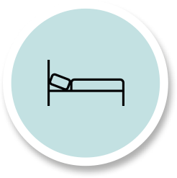
Insights on experience
Evaluation/Image
Travellers are very positive
about Flanders, even when
they’ve never visited
Service level
People who visited are very positive about the service they received
Restaurants, museums and places to stay are best evaluated
  General satisfaction
  Dissatisfaction level about their last visit is very limited
Hospitable
Family friendly
Easy to travel to
Good service/quality
A lot to offer
People in mature markets have a very positive image about Flanders and people who visited
are also very positive about the experience they had during their visit
VISITFLANDERS

Slide 24
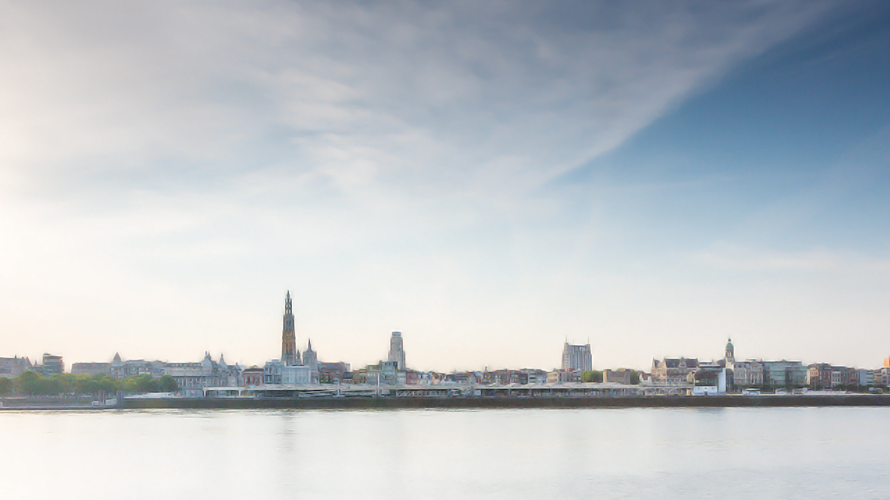

Connection with Flanders
The visit intention
VISITFLANDERS

Slide 25
Level of attraction
average
score/4
Visit intention
average
score/5
3,1
3,1
2,9
2,8
Attraction level is quite high for short breaks.
Almost one in three will (probably) not visit Flanders in the next 3 years.
VISITFLANDERS
Base: European market – all travellers familiar with Flanders or a city
Q8. To what extent do you think Flanders is an attractive destination for a holiday?
Q9. Are you planning on coming to Flanders for a short break or holiday within the next 3 years?:

Slide 26
Level of attraction
% very attractive
 | TOTAL EUROPE | NL | FR | DE | UK | ES | IT | NO | DK | SE | CH | AT | US | JP
Short break | 31% | 44% | 32% | 30% | 34% | 38% | 28% | 14% | 13% | 15% | 25% | 31% | 40% | 10%
Longer holiday | 22% | 12% | 16% | 16% | 20% | 39% | 32% | 11% | 12% | 11% | 17% | 15% | 52% | 22%
Visit intention
% Definitely
 | TOTAL EUROPE | NL | FR | DE | UK | ES | IT | NO | DK | SE | CH | AT | US | JP
Short break | 10% | 17% | 13% | 5% | 11% | 14% | 14% | 5% | 2% | 3% | 5% | 2% | 23% | 2%
Longer holiday | 8% | 4% | 8% | 4% | 9% | 13% | 15% | 5% | 2% | 2% | 4% | 1% | 26% | 4%
Flanders’ attraction level is highest in Spain and USA.
Dutch people show the biggest difference between short and longer stays: Flanders is only considered
as attractive for a short stay and visit intention for long stays is very limited.
VISITFLANDERS
Base: European market – all travellers familiar with Flanders or a city
Q8. To what extent do you think Flanders is an attractive destination for a holiday?
Q9. Are you planning on coming to Flanders for a short break or holiday within the next 3 years?

Slide 27
travellers with a visit intention
% Yes
Of all ‘assets’ that VISITFLANDERS is actively focusing on:
Historical heritage is the main driver to visit Flanders. Food & drinks and art & artists are also important drivers to visit.
VISITFLANDERS
Base: European market – all travellers familiar with Flanders or a city AND would (probably) visit Flanders
Q10. Which of the following aspects would be a reason for you to visit Flanders in the next few years? Multiple answers possible.

Slide 28
travellers with no visit intention
% Yes
The attraction of other destinations is the main reason why people don’t visit Flanders.
A limited knowledge of Flanders is another important reason.
VISITFLANDERS
Base: European market – all travellers familiar with Flanders or a city AND would (probably) NOT visit Flanders
Q11. Why are you (probably) not planning to visit Flanders in the next few years?

Slide 29
 | TOTAL EUROPE | NL | FR | DE | UK | ES | IT | NO | DK | SE | CH | AT | US | JP
Flanders | 21% | 9% | 12% | 20% | 26% | 22% | 28% | 24% | 16% | 19% | 22% | 21% | 36% | 56%
Brussels | 26% | 25% | 13% | 25% | 28% | 24% | 39% | 30% | 22% | 26% | 29% | 29% | 32% | 59%
Belgium | 21% | 8% | 12% | 20% | 26% | 23% | 30% | 27% | 17% | 21% | 24% | 22% | 32% | 57%
Total europe
Flanders
brussels
belgium
1 out of 4 (or less) European travellers would avoid visiting Flanders, Belgium or Brussels because
of the terror attacks in 2016. In Japan, the USA and Italy, however, this percentage is significantly higher.
VISITFLANDERS
Base: European market – all travellers familiar with Flanders or a city
Q27. Would you avoid traveling to this region because of the terror attack of March 2016? (% yes)

Slide 30
Insights on visit intention
Visit intention
1 out of 3
European travellers
would (probably) visit Flanders
in the next 3 years,
1 out of 3
would not visit Flanders
Americans have the highest
visit intention, while Dutch
people would only visit for a
short stay, but not for a longer holiday
Assets & Barriers
Main assets (of VISITFLANDERS focus) = Heritage & Food and Drinks & Art.
The attraction level of other destinations is the main barrier not to visit Flanders. This barrier is greatest in The Netherlands and France. Note that a lack of knowledge about the region is a second important barrier.
  Impact of terror attacks
  1 out of 4 (or less) European travellers would avoid traveling to Flanders because of the terror attacks in 2016. This share is higher in the USA and Japan.
56%
36%
28%
VISITFLANDERS

